Slide 1
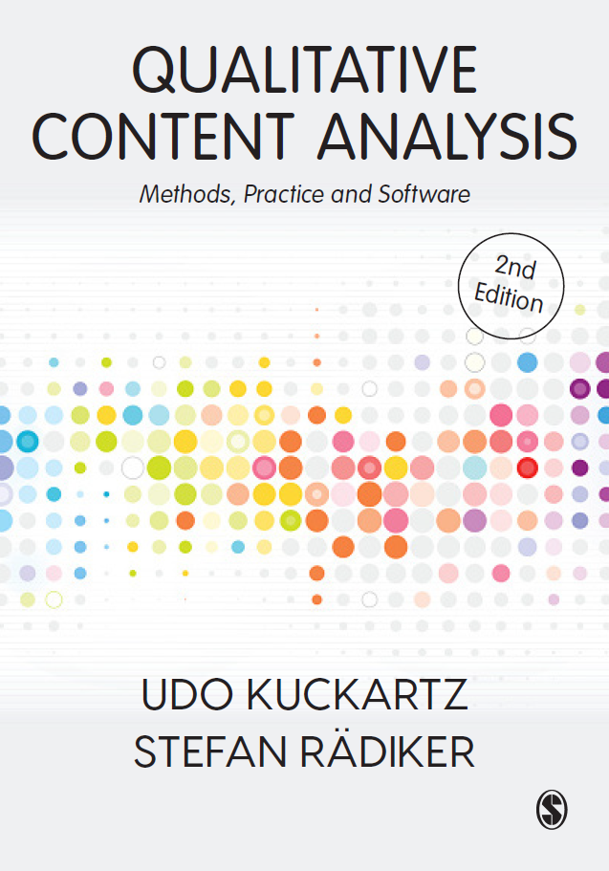
Welcome to the world of qualitative content analysis! Definition, Categories, Process Udo Kuckartz & Stefan Rädiker March 2023 qca-method.net

Slide 2
What is qualitative content analysis?
“Qualitative content analysis is the systematic and methodologically controlled scientific analysis of texts, pictures, films, and other contents of communication.
Not only manifest but also latent contents are analysed. At the centre of qualitative analyses are categories with which all the material relevant to the research question(s) is coded. Category development can be deductive, inductive, or deductive-inductive.
The analysis is primarily qualitative but can also integrate quantitative-statistical evaluations; it can be both category-oriented and case-oriented.”
(Kuckartz & Rädiker, 2023, p. 21)

Slide 3
What types of categories can be distinguished?
TYPE OF CATEGORY | WHAT FOR? | EXAMPLE
Factual categories | Capturing facts mentioned | Second degree; Baker
Thematic categories | Capturing contents and topics addressed | Learning behaviour
Evaluative, scaling categories | Evaluating contents by the researchers | Motivation to study (e.g., with characteristics low, medium, high)
Analytical categories | Labelling and explaining of “what is going on” | Cost-benefit analysis
Theoretical categories | Analytical category with reference to existing theory | Rational choice decision
Natural categories | Adoption of formulations from the data material | “the eco-woman”
(Ordering categories) | Structuring the category system itself
…

Slide 4
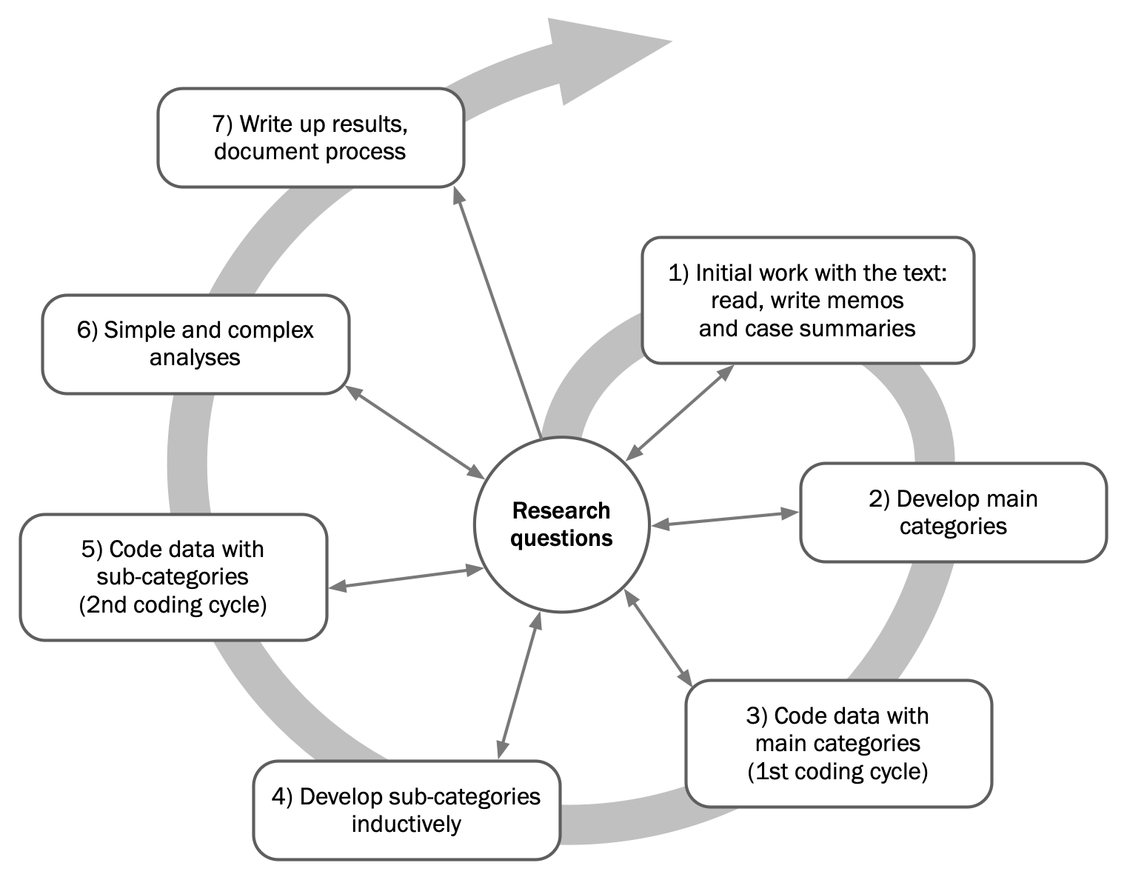
How does structuring QCA proceed?

Slide 5
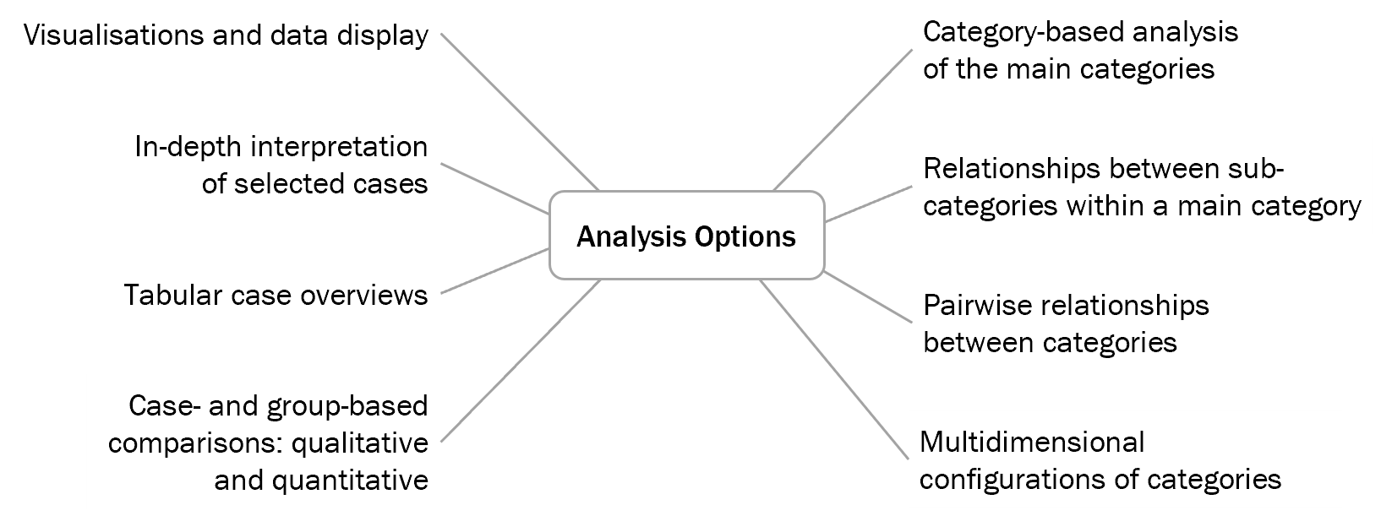
Analysis options after coding in structuring QCA

Slide 6
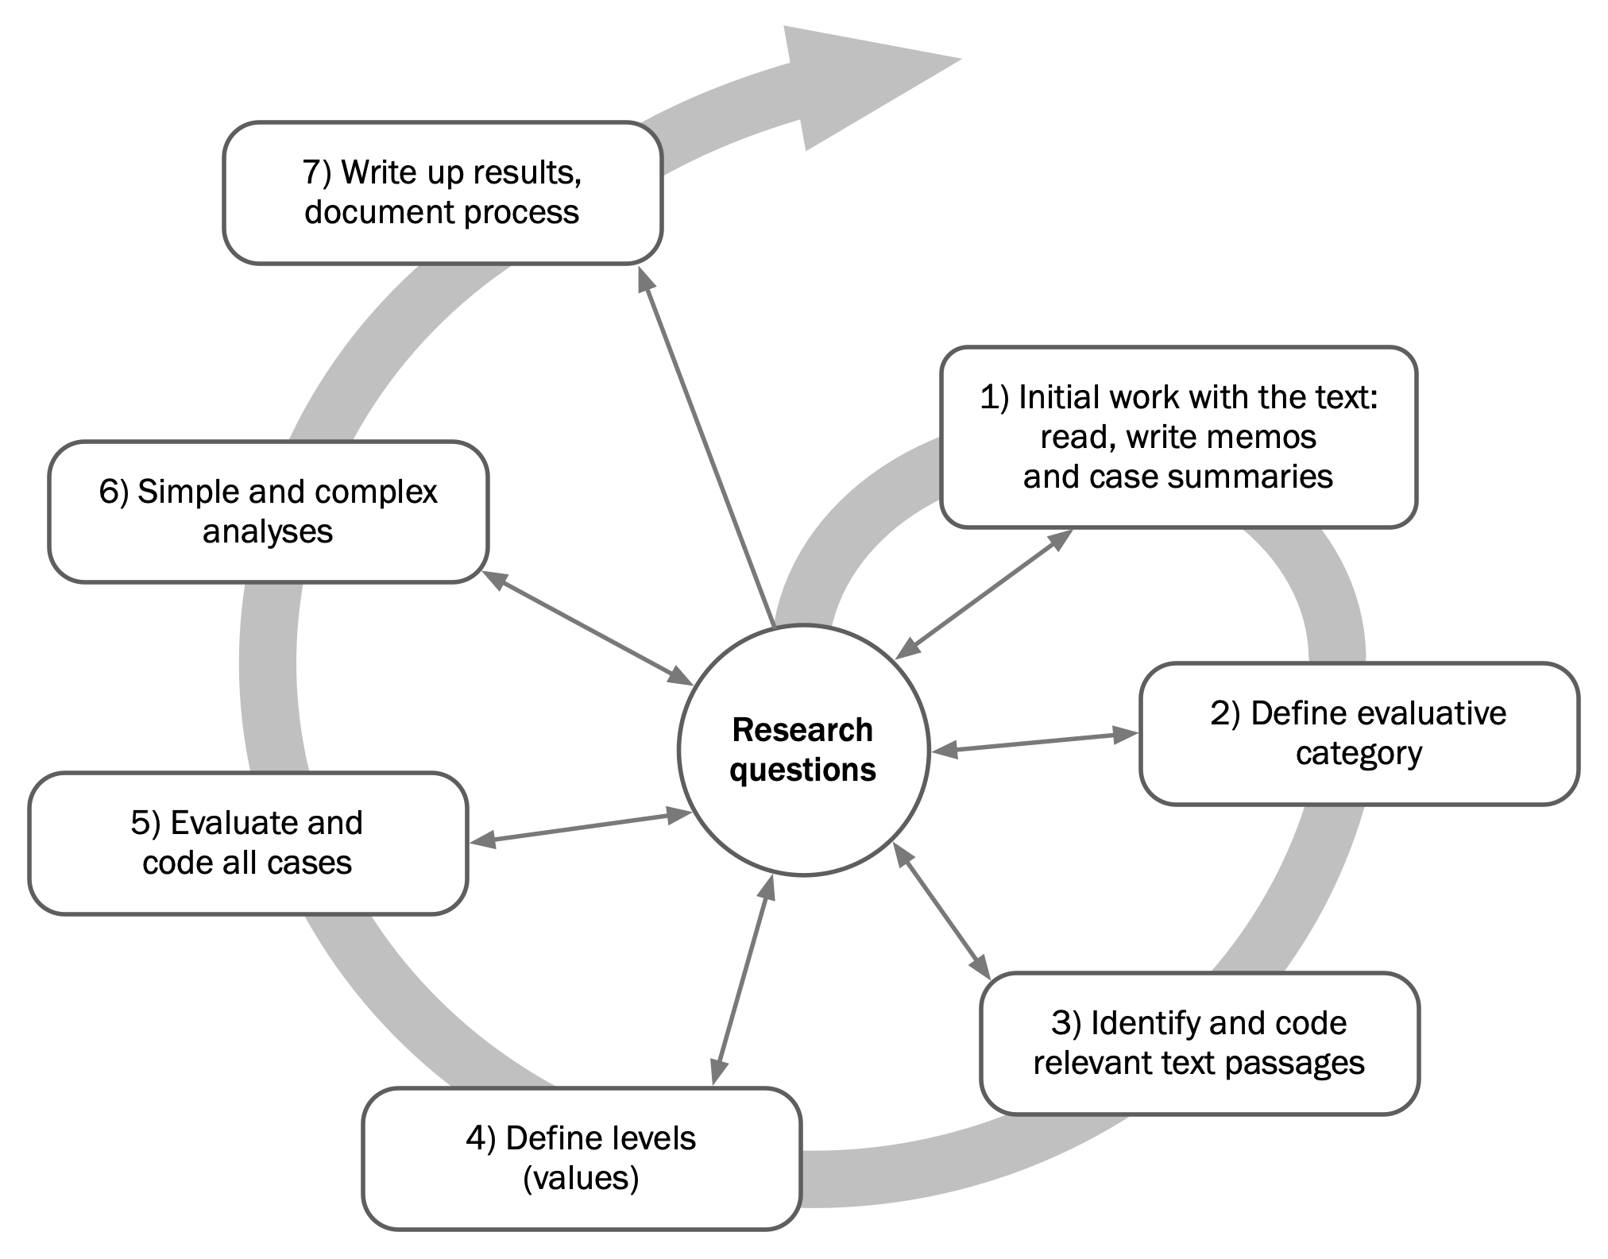
How does evaluative QCA proceed?

Slide 7
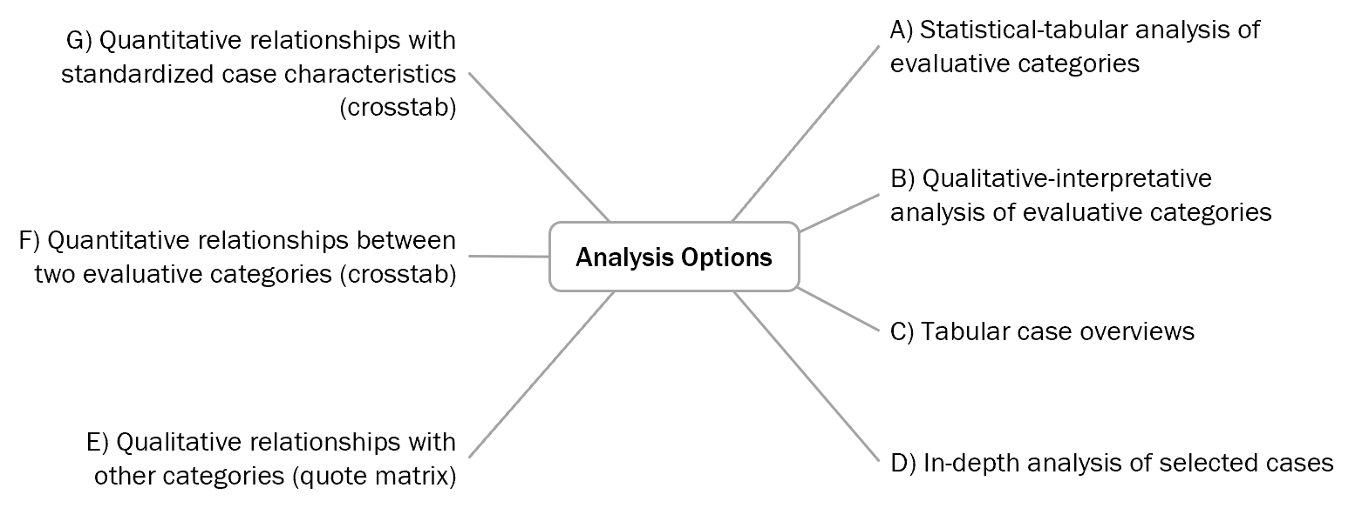
Analysis options after coding in evaluative QCA

Slide 8
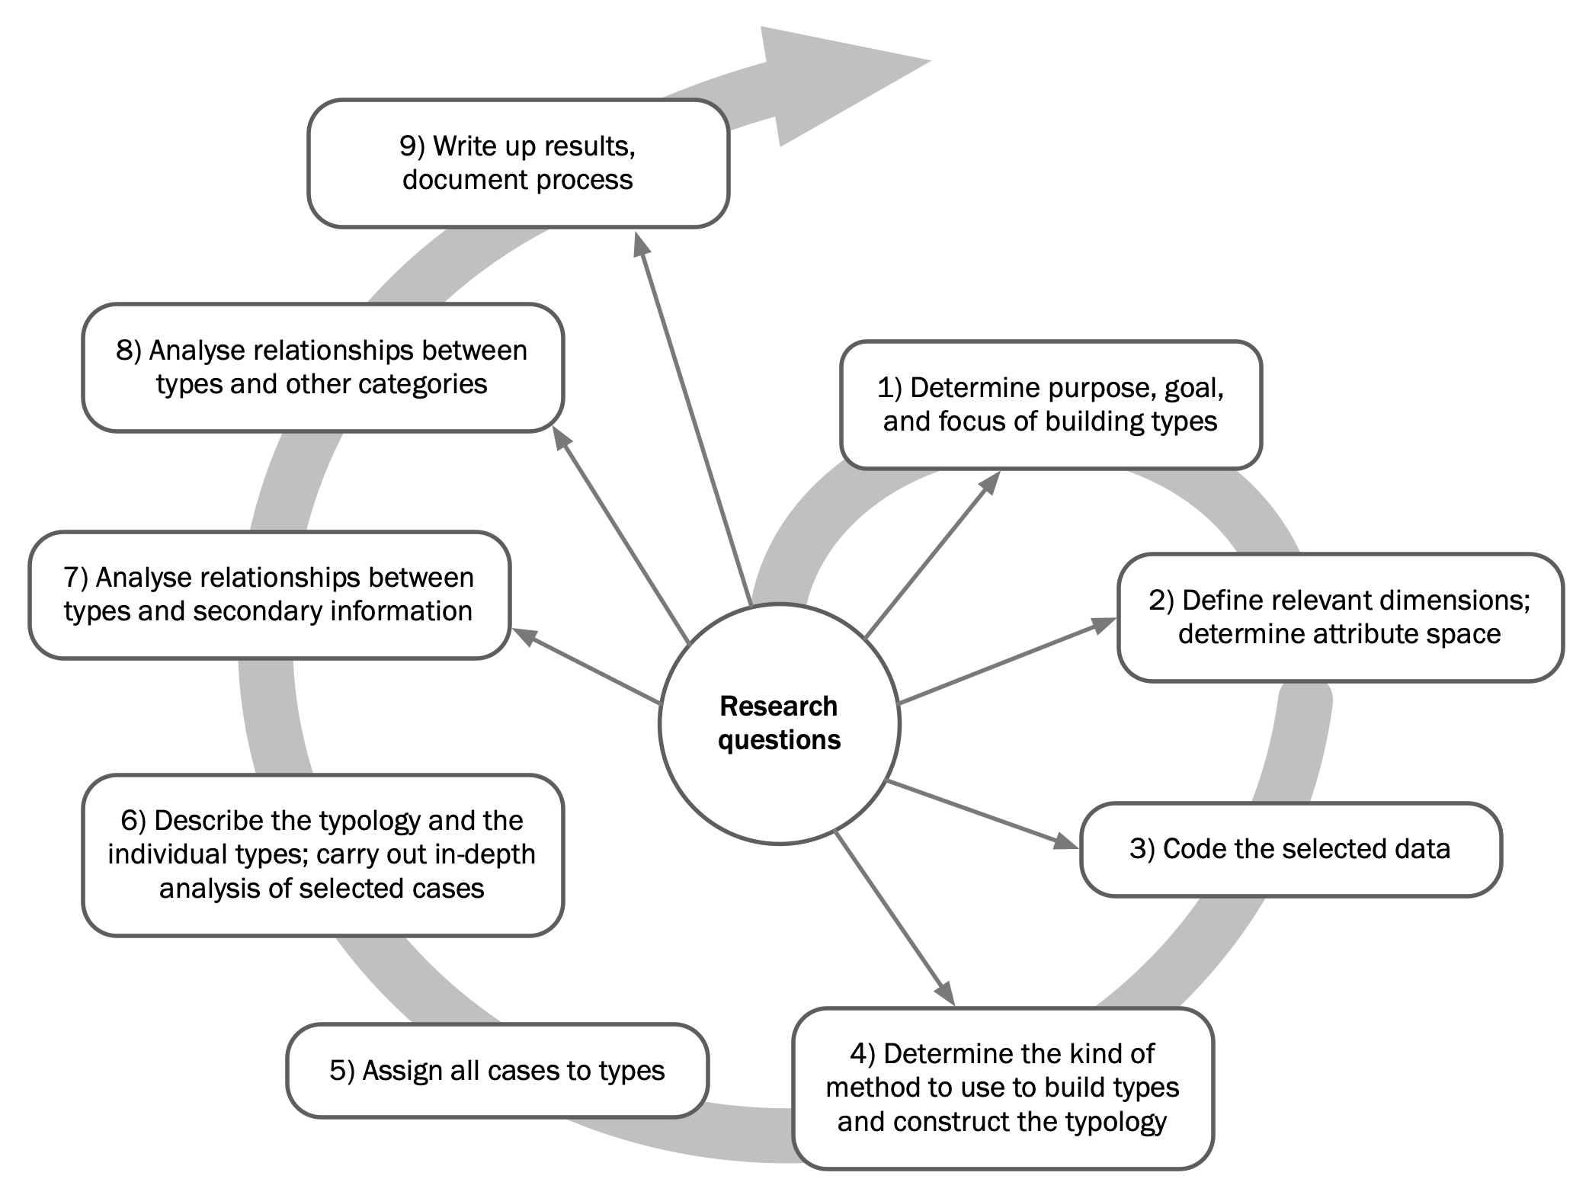
How does type-building QCA proceed?

Slide 9
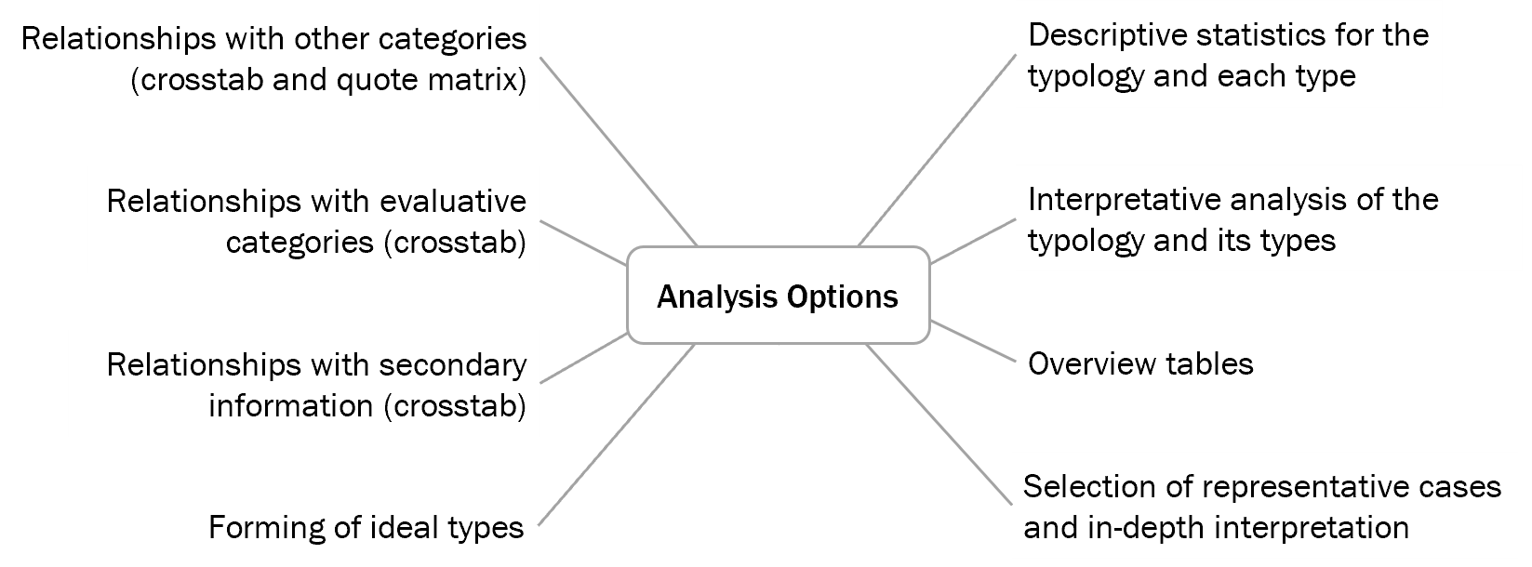
Analysis options after creating a typology

